Slide 1

Satellite 101, Part 1
NOAA Coastwatch Satellite Course
Last Updated: 10/20/2020
coastwatch.info@noaa.gov
Notes:
Welcome to Part 1 of Satellite 101, part of an online course on oceanographic satellite data products, which has been produced by NOAA’s CoastWatch
Program. My name is Cara Wilson, I’m the node manager of the West Coast Node of NOAA’s CoastWatch Program. The materials I will present in
this video were produced from a collaboration from many members of NOAA’s CoastWatch Program including Dale Robinson, Melanie
Abecassis, Ron Vogel, Shelly Tomlinson, myself, and the late Dave Foley.

Slide 2
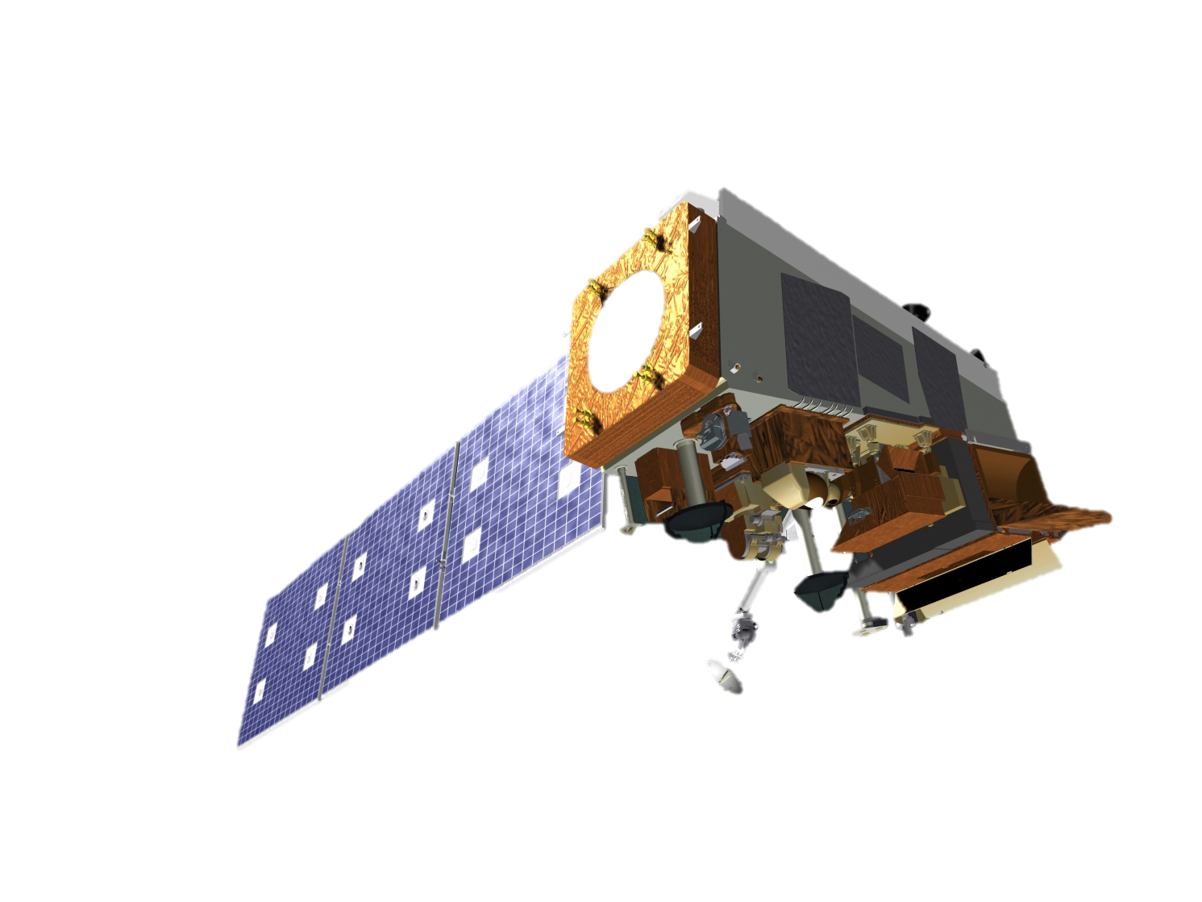
What is covered in this presentation
  Part 1:
  Overview of available satellite products
  Different Types of Orbits
  Different Resolutions and Spatial Coverages
  Levels of Data Processing
  Part 2:
  Types of Sensors and Measurements
Notes:
In part 1 of the Satellite 101 presentation, I will introduce some of the basic terminology used in the field of remote sensing. I will give an overview of available oceanographic satellite products and present the different types of orbits, resolutions and spatial coverages. I will also briefly go over the different levels of data processing. In part 2 of the Satellite 101 presentation, I will introduce the different types of satellite sensors and how measurements are made. There are also additional presentations as part of the CoastWatch course that go into more detail about how certain measurements and products are made.

Slide 3
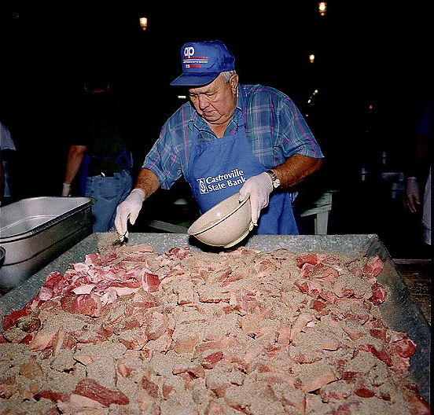
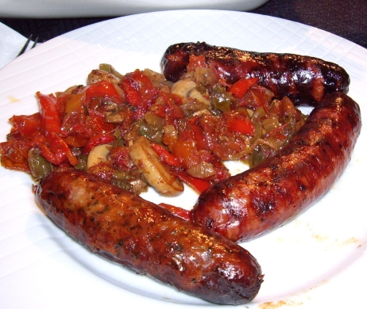
Sausage Making vs Sausages
What goes into making satellite products: EMR, wavelength bands, IOPs, radiances, atmospheric correction, lunar calibration, absorption spectra, cloud masks…
Using the data for your specific application
Notes:
I like to use a food analogy to explain the approach of this course. I’m not a vegetarian and I like sausages, but I’d prefer to not know what goes into them – it’s often a lot of nasty body parts! And I feel the same way about satellite data. I just want to use the data without having to learn about all the processes that go into creating these products – information about electromagnetic radiation, wavelength bands, IOPs and AOPs, atmospheric correction, lunar calibration etc etc. But just as one has to make some decisions when buying sausage at the store – chicken or pork, or tofu for my vegetarian friends, nitrate-free or not, one has to know a little bit about satellite products when using them. In this course we aim to give you the basic information you need to make decisions about choosing a satellite product to use. This course does not intend to teach the “sausage making” components of satellite data. That amount of detail needs a much longer and comprehensive course.

Slide 4
What oceanographic measurements are made by satellites?
Sea Ice
Sea Surface Temperature (SST)
Sea Surface Height (SSH)
Chlorophyll (ocean color)
Rainfall
Surface Vector Winds (SWV)
Sea Surface Salinity
For how long?
Notes:
So what measurements of the ocean can we make from satellites?
We can measure the amount and type of sea ice, we can measure sea-surface temperature, or SST for short. We can measure sea-surface height of the ocean, or SSH for short. By measuring ocean color we can derive the chlorophyll concentration of the surface ocean. We can also measure the speed and direction of ocean currents and winds over the ocean, the amount of rainfall over the ocean, as well as the sea surface salinity.
For how long have we been making these measurements?

Slide 5
What oceanographic measurements are made by satellites?
since 1978¹
since 1981
since 1992
since 1997²
since 1997
since 1999³
since 2011
Sea Ice
Sea Surface Temperature (SST)
Sea Surface Height (SSH)
Chlorophyll (ocean color)
Rainfall
Surface Vector Winds (SWV)
Sea Surface Salinity
For many applications we want to know how the oceans are changing over time, so we need long timeseries of consistent measurements
¹The consistently processed satellite passive microwave record of sea ice concentration begins in 1978, but other data extends to 1966.
²The continuous record of ocean color sensors extends back to 1997, but the CZCS mission flew from 1979-1986.
³ Wind speed, without direction, dates back to 1988
Notes:
The answer depends on the measurement.
On this slide the different measurements are arranged in order of the length of the timeseries. Measurements of sea ice have been collected the longest, with the continuous record going back to 1978. The salinity is a relatively new measurement, which started in 2011. Note that the years shown here indicate the start of the continuous record of each of these parameters, but in some cases the first measurements were made earlier. For example the first ocean color satellite was the CZCS, the Coastal Zone Color Scanner, which flew from 1979 to 1986, but there was a ten year gap between that data and the launch of SeaWiFS in 1997, which marks the beginning of the continuous record of ocean color measurements.

Slide 6








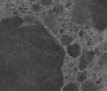
Timeline of satellite missions
1987
1998
2001
2005
2012
2016
2020
Notes:
6
This slide shows a little bit more graphically the progression of different oceanographic satellite missions over the last few decades. Not only has the number of available products been growing, but also the number of satellites, and now there can be multiple satellites measuring the same parameter. Many countries have satellite programs, and there is international cooperation and data sharing.

Slide 7
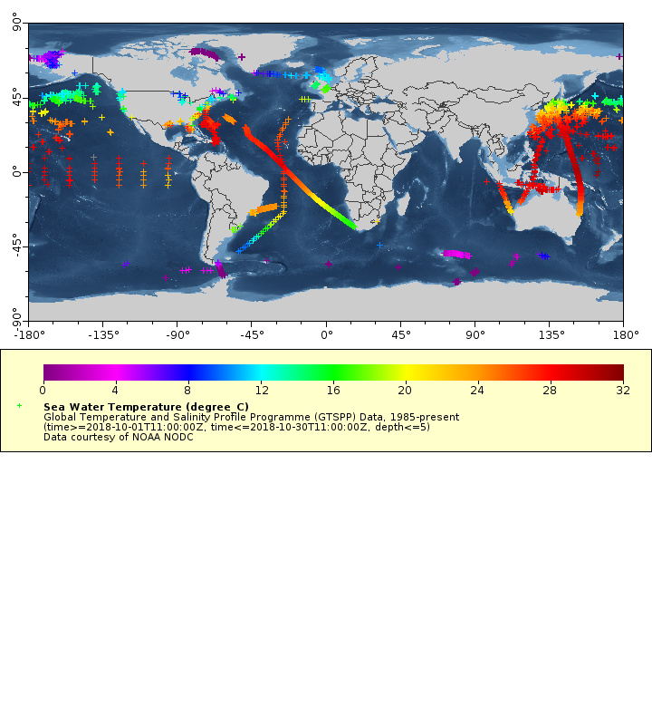
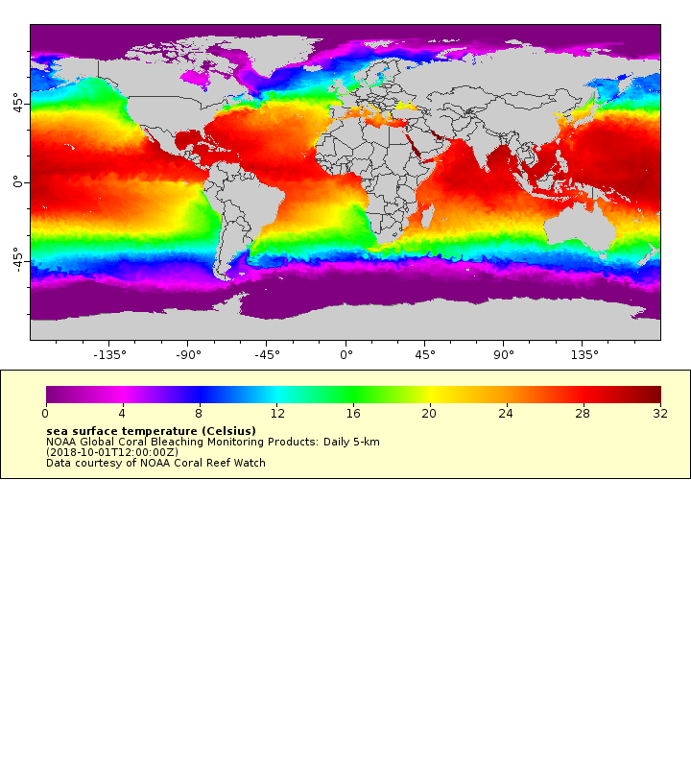
Benefits of satellite data
1 month of in situ SST data 1 day of merged SST satellite data
Satellite data provides observations of the ocean at temporal and spatial scales that are impossible to achieve with traditional in situ measurements
Timeseries of satellite data make it possible to detect anomalous conditions and ‘observe’ past events
Notes:
So why do we need satellite data? The oceans are huge, covering 71% of our planet, and it is impossible to adequately measure them with in situ measurements. Satellite data is able to provide us measurements of the ocean at temporal and spatial scales that we could never cover with ships or buoys, alone. The image on the left shows a compilation of all the in situ sea-surface temperature data collected in a month, and the image on the right shows a compilation of all the satellite sea-surface temperature data collected in one day! Having continuous satellite measurements makes it possible to detect anomalous events and also to go back and observe past events using the archived record of measurements. An important caveat though is that the satellite measurements are just of the surface of the ocean, so for information on the subsurface structure of the ocean we need to rely on a combination of in situ data and ocean models.

Slide 8
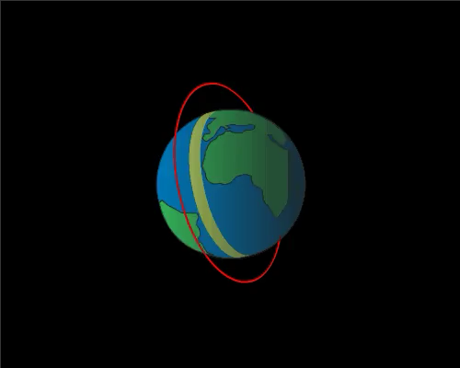
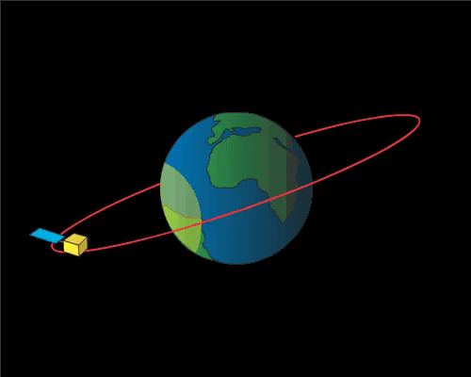
Satellite orbits
Image credit: NASA ARSET
Image credit: NASA ARSET
Polar-orbiting satellites view most of the earth once a day
Altitude: 700-800 km
Geostationary satellites view a limited region of the earth, but do so continuously throughout the day
Altitude: 35,800 km
Most oceanographic satellite measurements come from polar-orbiting satellites
Some SST measurements are made from geostationary satellites
South Korea has an ocean color sensor on a geostationary satellite
Notes:
There are two main types of satellites orbits – polar-orbiting and geostationary. The animation on the left depicts a polar-orbiting satellite. As the name implies the satellite orbits around the poles of the earth, as the earth spins, the satellite measures a swath below it. In the course of one to several days the satellite will have passed over the entire globe. Geostationary satellites have orbits that are in sync with the Earth’s orbit, so they are always looking at the same area of the Earth, allowing frequent measurements over the region instead of only one measurement per day. Geostationary satellites sit a lot farther away from the earth than polar-orbiting satellites and therefore can observe much more surface area. Most of our environmental data comes from polar-orbiting satellites, and most of our weather data comes from geostationary satellites. Some SST measurements are made from geostationary orbit, and South Korea has an ocean color sensor on a geostationary satellite.

Slide 9
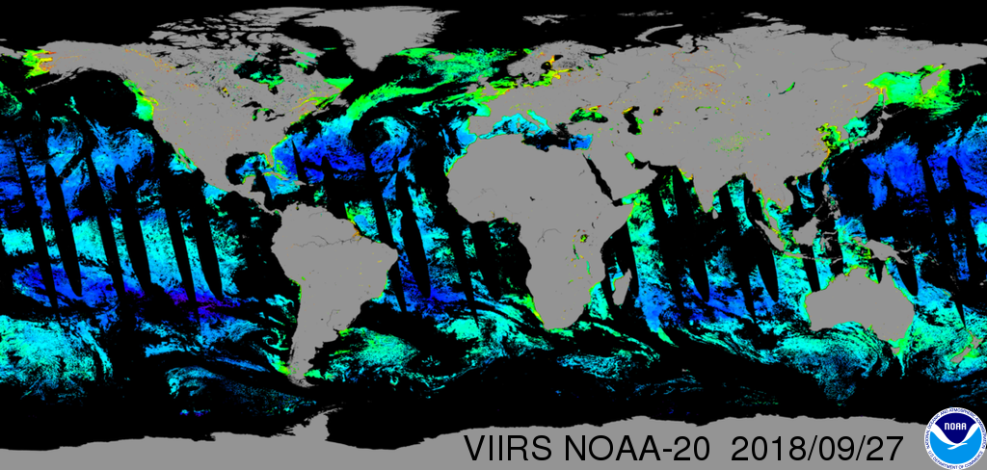
Polar Orbit
Notes:
This image shows all the data collected in one day by the polar-orbiting VIIRS ocean color sensor on the NOAA-20 satellite. The black area are regions where no measurements were made. The streaks running north to south through the image are areas where the satellite did not pass over. The other black regions are regions where measurements were not made because of cloud coverage.

Slide 10
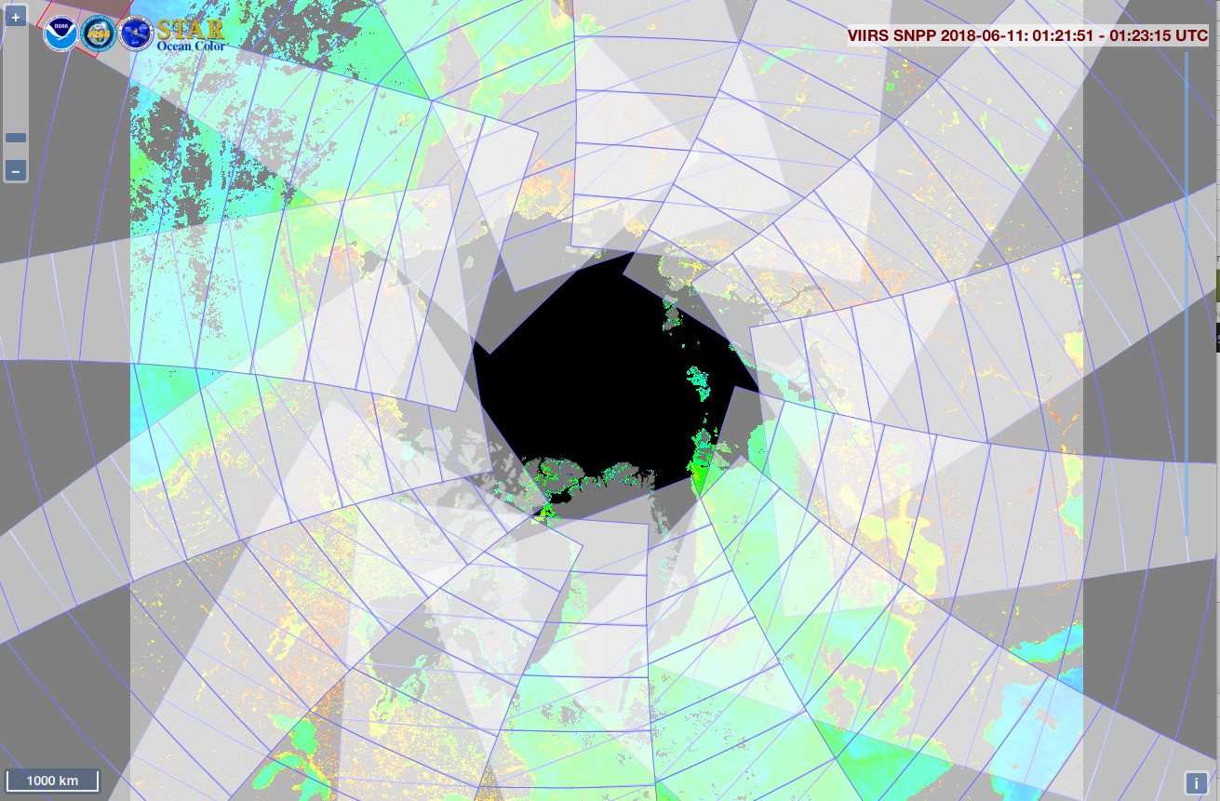
Polar Orbit
from https://www.star.nesdis.noaa.gov/sod/mecb/color/ocview/ocview.html
Notes:
While there are some areas on the globe that will be missed each day by a polar-orbiting satellite, because each pass goes over the poles, they collect a lot of data at high latitudes. This image shows the 14 passes made in one day of the SNPP satellite over the north pole.

Slide 11
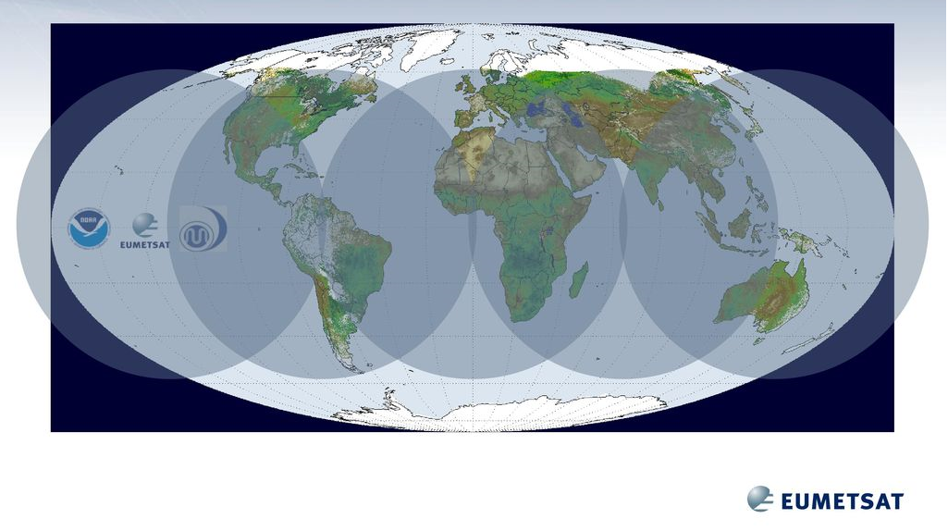
Geostationary coverage
Geostationary satellites aren’t much use in polar regions!
GOES-West GOES-East MeteoSat. MeteoSat Himawari
GOES-West (US), GOES-East (US), MeteoSat x2 (Europe), Himawari (Japan)
-> 5 satellites for global coverage
Notes:
Here we can see the global coverage of geostationary satellites. Because each satellite can only observe part of the planet, multiple satellites are needed to provide global coverage. We need two satellites to adequately cover the United States, we have GOES-West and GOES-East. Those satellites, combined with the two European satellites and the Japanese geostationary satellite, can provide nearly global coverage.
However even the two US geostationary satellites do not cover and all of the United States. Their coverage does not extend into high latitudes and unfortunately we can’t currently make geostationary measurements over much of Alaska.

Slide 12
Polar vs Geo Orbits
Polar
Altitude: 700-800 km
~ 14 orbits a day
Global coverage
High spatial resolution (< 1 km)
Low temporal resolution (≥ 1 day)
Geo
Altitude: 35,800 km
Poor coverage of the poles
Regional coverage only
Low spatial resolution (2-4 km)
High temporal resolution (< hour)
Higher spatial resolution generally means lower temporal resolution, and vice-versa.
You can’t have everything!
Notes:
This slide summarizes the difference between polar-orbiting satellites and geostationary satellites. Polar-orbiting satellites provide global coverage, at relatively high spatial resolution, on the order of 1 km resolution, but a low temporal resolution, on the order of 1 or 2 days. In contrast geostationary satellites provide regional coverage, at lower spatial resolution, on the order of 2-4 km, but high temporal resolution, with approximately hourly resolution. With satellite data there is always a trade-off when it comes to resolution – higher temporal resolution means lower spatial resolution, and vice-versa. You can’t have both!

Slide 13
What Resolution?
Spatial resolution is the pixel size of the image. The resolution of oceanographic satellite products ranges from 250 m – 25 km.
Temporal resolution is the amount of time that passes between subsequent images at the same point.
Spectral resolution refers to how many bands the sensor has.
Swath width refers to the width of the area observed by the satellite (polar-orbiting). Satellites with larger swath widths will take less time to acquire global spatial coverage.
Notes:
I’ve mentioned the different types of resolution of satellites, let’s talk about that a little more. “Resolution” of a satellite can refer to a number of things. The spatial resolution is the smallest geographic area that a satellite instrument can resolve. The spatial resolution of oceanographic satellite products ranges from 250 m – 25 km. The higher the spatial resolution, the more details that can be observed. The Temporal resolution is how frequently a satellite observes the same area on Earth. The Spectral resolution refers to how many bands the sensor has. The higher the spectral resolution, the more specific types of observations are possible with the same instrument. Another relevant specification is the Swath width, which refers to the width path observed by a polar-orbiting satellite as it orbits that Earth. Satellites with larger swath widths typically have a greater temporal resolution and a lower spatial resolution.

Slide 14
High Spatial Resolution Satellites
There are a number of high spatial resolution imaging sensors, ~1-30 m,
e.g. SPOT, QuickBird, IKONOS, OrbView-3, Hyperion, WorldView
The trade-off is temporal resolution, and these sensors generally have very long repeat-times. Some don’t have regular repeat times, but rather work on a system of scheduled, on-demand acquisitions.
These data are generally better suited for land applications than for ocean applications.
Most of the data has to be purchased, or is difficult to get a hold of.
These data are generally not offered as part of this course.
Notes:
There are other satellites that have higher spatial resolutions, on the order of 1 to 30 meters, compared to the 1-25 kms we deal with in ocean remote sensing. I previously mentioned the trade-offs inherent with different resolutions. These very high spatial resolution sensors can have very long repeat times, or might not have any repeat times at all, but rather work on on-demand acquisition. These data can be challenging to obtain and cumbersome to process, and often better suited for land applications than for ocean applications.

Slide 15
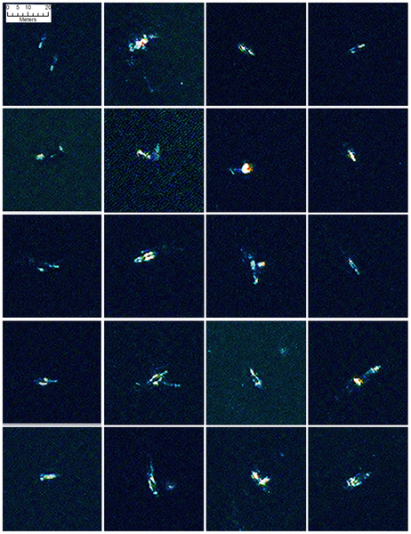

Whales from Space
Figure 2. A selection of 20 comparable false colour image chips (bands 1-8-5) of probable whales found by the automated analysis.
“The WorldView2 satellite has a maximum 50 cm resolution and a water penetrating coastal band in the far-blue part of the spectrum that allows it to see deeper into the water column. Using an image covering 113 km², we identified 55 probable whales and 23 other features that are possibly whales, with a further 13 objects that are only detected by the coastal band.”
Fretwell PT, Staniland IJ, Forcada J (2014) Whales from Space: Counting Southern Right Whales by Satellite. PLoS ONE 9(2): e88655. doi:10.1371/journal.pone.0088655
http://www.plosone.org/article/info:doi/10.1371/journal.pone.0088655
Notes:
Although these high resolution data are not generally offered as part of this course, I will show you a cool example of a study that used one high resolution datset for an oceanographic application. This study used data from the WorldView sensor, which has a 50 cm resolution, to try to identify whales off of Península Valdés in Argentina. The white objects in the images are probable whales that were identified by automated analysis.

Slide 16
Levels of Data
Level 0: Raw data received from satellite, in standard binary form
Level 1: Unprocessed data in sensor’s geographic coordinates, containing calibration information
Level 2: Derived geophysical variables atmospherically corrected and geolocated, but presented in sensor’s geographic coordinates (granules).
Also sometimes referred to as “along-track” data.
Level 3: Derived geophysical variables mapped on uniform space-time grid scales. Spatial and temporal composites.
Level 4: Model output or results from analyses of lower-level data
e.g., variables derived from multiple measurements, like primary productivity
or interpolation to provide cloud-free product
This course focuses primarily on level 3 and level 4 data
Notes:
A lot of processing goes into satellite data before reaching you, the sausage making that I referred to earlier. There are terms to refer to how processed the data are. For example Level 0 data is the raw data received from the satellite, level 1 data has been put into the satellite’s geographical coordinates (i.e “along-track”) , level 2 data has been processed into a derived geophysical variable, like sea surface temperature, but is still in swath coordinates. Level 3 has been mapped onto a standard map grid with latitude and longitude. Level 4 data has had an additional degree of analysis performed, perhaps deriving another product, performing interpolation to remove gaps, temporal compositing etc. This course focuses on accessing and using level 3 and level 4 data, ie “off the shelf” data products.

Slide 17
Temporal Composites
Composites product are the best way to deal with missing data due to cloud coverage
Level 3C: Collated, or Temporal Composites
Data from different time periods from the same sensor are collated together
Example: Blending 7 (or 8) days of VIIRS Chl data into a weekly composite
Level 3S: Super-collated or Blended Products
Data from different time periods and different sensors are collated together.
Example: Blending data from geostationary and polar-orbiting IR sensors
Notes:
Let’s talk briefly about temporal composites. Many satellite products contain gaps where there are no measurements due to cloud coverage. These gaps can be at least partially filled in by making composites, or averages of different satellite images. There are two different ways this can be done. Temporal composites of a sensor can be made over longer time periods. Most satellite products are composited into daily, weekly and monthly products. For measurements that are made by multiple satellites, blended products can be made that merge data from the different sensors.

Slide 18
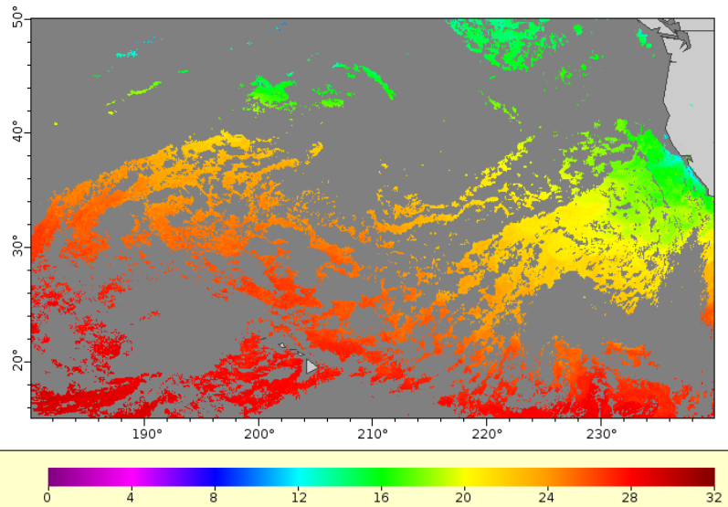
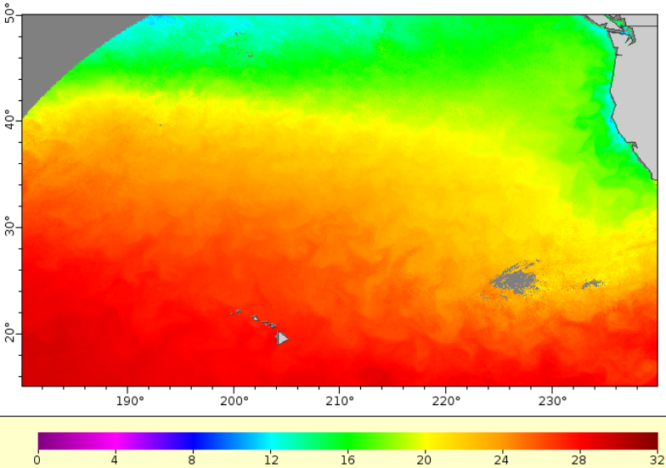
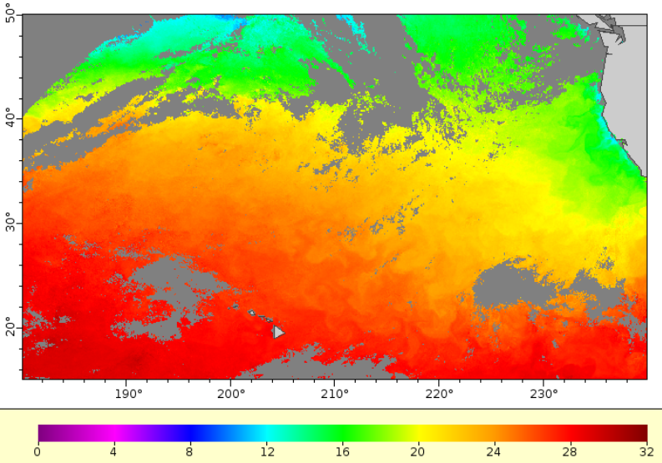
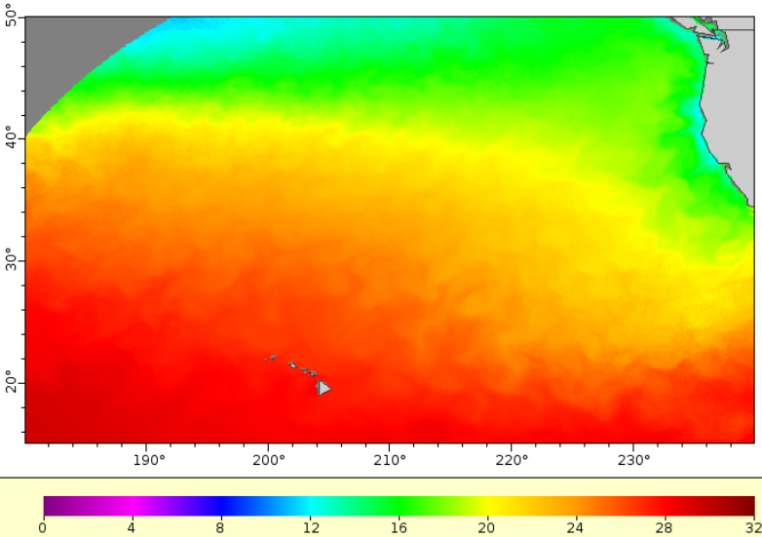
Example of Temporal Compositing
Level of data processing
GOES West SST – September 2018
Sept 15
Hourly Image
Sept 15
Daily Composite
Sept 12-18
Weekly Composite
Sept
Monthly Composite
Notes:
This slide shows an example of 4 different temporal composites of geostationary sea-surface temperature data in the Pacific Ocean. The image on the top left displays one hour of data from Sept 15 2018. There are more areas with missing data than there are areas with data. The image on the bottom left shows a daily composite of data from this same sensor, and most of the missing data from the image above it are now filled in. The image on the top right shows a weekly composite of the same area. Now there is only a small region with no data, around longitude of 230°, where it has been cloudy all week. The monthly composite in the bottom right is gap-free, except for the region in the northwest part of the map, which is outside of the disk view of the satellite.

Slide 19
Cloud Masking
Level of data processing
Cloud masks are necessary for measurements that can’t see through clouds, such as SST and ocean color
Since cloud masks are usually made from visible imagery, cloud masks for nighttime retrievals of SST are less accurate than for daytime retrievals
Different agencies and different satellite product producers use different cloud masks.
Notes:
The composites we’ve just seen are necessary to make because of data gaps due to cloud coverage. The cloud issue is a huge problem for ocean remote sensing. But of course the satellite doesn’t stop making measurements when there are clouds, but rather it makes measurements of the cloud, not the ocean below it. So in order to remove this cloud data we need cloud masks that determine what data is from a cloud and what is from the ocean. Cloud masks are usually made from visible imagery, so nighttime retrievals of SST can be less accurate, since the cloud masks might not be as reliable. Different agencies and different satellite products can use different masks.

Slide 20
Anomaly Products and Climatologies
For many applications an anomaly is more useful than the actual parameter. Anomalies are generated by subtracting a climatology of that parameter.
We have a limited number of products with anomalies:
 | MUR | NOAA Global Coral Bleaching | OSU SST and Chlorophyll Anomalies (MODIS)
Temporal Coverage | 2002 - now | 1985 - now | 2003 - now
Temporal Resolution | Daily & Monthly | Daily | Monthly
Spatial Resolution | 1 km | 5 km | 2 km, West Coast only
Products | SST | SST | SST and Chlorophyll
ERDDAP link | https://coastwatch.pfeg.noaa.gov/erddap/griddap/jplMURSST41anommday.graph | https://coastwatch.pfeg.noaa.gov/erddap/griddap/NOAA_DHW.graph?CRW_SSTANOMALY | https://coastwatch.pfeg.noaa.gov/erddap/griddap/osu2SstAnom.graph https://coastwatch.pfeg.noaa.gov/erddap/griddap/osu2ChlaAnom.graph
Notes:
For many applications it is more useful to view how a parameter differs from a typical or mean value. This is called an anomaly product. For example, to see
the extent of the recent marine heat wave in the North Pacific, one needs to look at the Sea Surface Temperature anomaly, rather than Sea Surface Temperature. To generate an anomaly one needs a climatology mean of the parameter to subtract from the timeseries. Here I have listed some of the anomaly products served by CoastWatch.

Slide 21
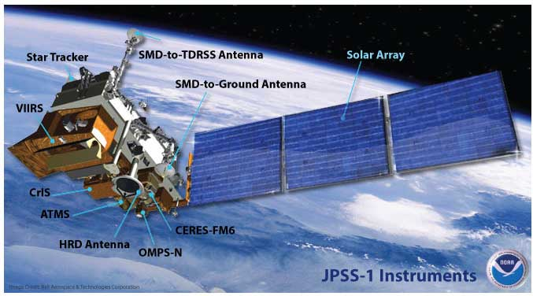
Satellite vs Sensor
VIIRS:
Visible
Infrared
Imaging
Radiometer
Suite
Some satellites are single-mission, carrying only one sensor, e.g. the SeaWiFS sensor on the GeoEye/OrbImage satellite. Other satellites have multiple sensors on them, as the JPSS satellites do. The same sensor can be on multiple satellites, ie VIIRS on SNPP and NOAA-20
Notes:
It’s important to realize the distinction between satellites and sensors. Sensors are the instruments making the measurements. Satellites are the platforms carrying the sensors. Currently most satellites have many different sensors on them. This slide shows all of the sensors on the JPSS-1 (NOAA-20) satellite. One of these sensors is VIIRS, a sensor which is also on the SNPP satellite which was launched a number of years before JPSS-1

Slide 22

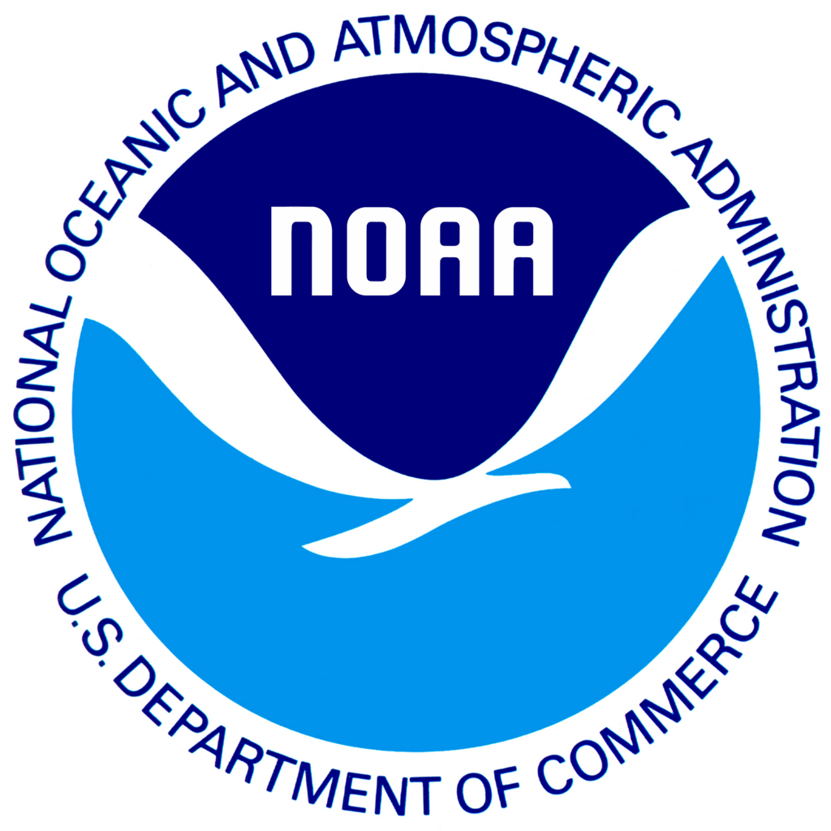

US Satellite Agencies
NASA
National Aeronautic and Space Agency
Responsible for satellite research and development
NOAA
National Oceanic & Atmospheric Administration
Responsible for operational satellites for routine uses
Joint Polar Satellite System (JPSS):
a collaborative multi-satellite mission between NOAA and NASA
DOD
Department of Defense
Responsible for military satellites
Notes:
22
In closing I’ll mention the two major satellite agencies in the US, NASA and NOAA. Both agencies have satellite missions but they have different responsibilities and objectives. NASA is responsible for research and development of satellite instruments and products, whereas NOAA’s role is to provide operational satellite data for routine use. Those are two very different objectives. NOAA needs to measure and expand how its satellite products are being used operationally, in order to ensure a continuous and reliable suite of environmental measurements. And that need is indeed what led to the development of the NOAA CoastWatch satellite course many years ago. Oceanographic satellite data was being underutilized within the ‘wet’ part of NOAA, ie NMFS and NOS, and this course was created to increase the utilization of satellite data within NOAA, and in other operational applications.
More details on how satellite measurements are made are presented in Part 2 of the Satellite 101 presentations

Slide 23
NOAA CoastWatch Satellite Course - Narrated Presentations
Satellite 101 – Part 1
Satellite 101 – Part 2
Fundamentals of Ocean Color
Fundamentals of Sea-Surface Temperature
Fundamentals of Altimetry, Wind and Salinity
Introduction to ERDDAP
What Dataset to Choose?
Bringing Satellite Data into ARCGIS

