Slide 1

Satellite 101, Part 2
NOAA Coastwatch Satellite Course
Last Updated: 10/20/2020
coastwatch.info@noaa.gov
Notes:
Welcome to Part 2 of Satellite 101, part of of an online course on oceanographic satellite data products, produced by NOAA’s CoastWatch Program. My name is Cara Wilson, I’m the node manager of the West Coast Node of NOAA’s CoastWatch Program. The materials that I will be presenting in this video were produced from a collaboration from many members of NOAA’s CoastWatch Program including Dale Robinson, Melanie Abecassis, Ron Vogel, Shelly Tomlinson, me and the late Dave Foley.

Slide 2
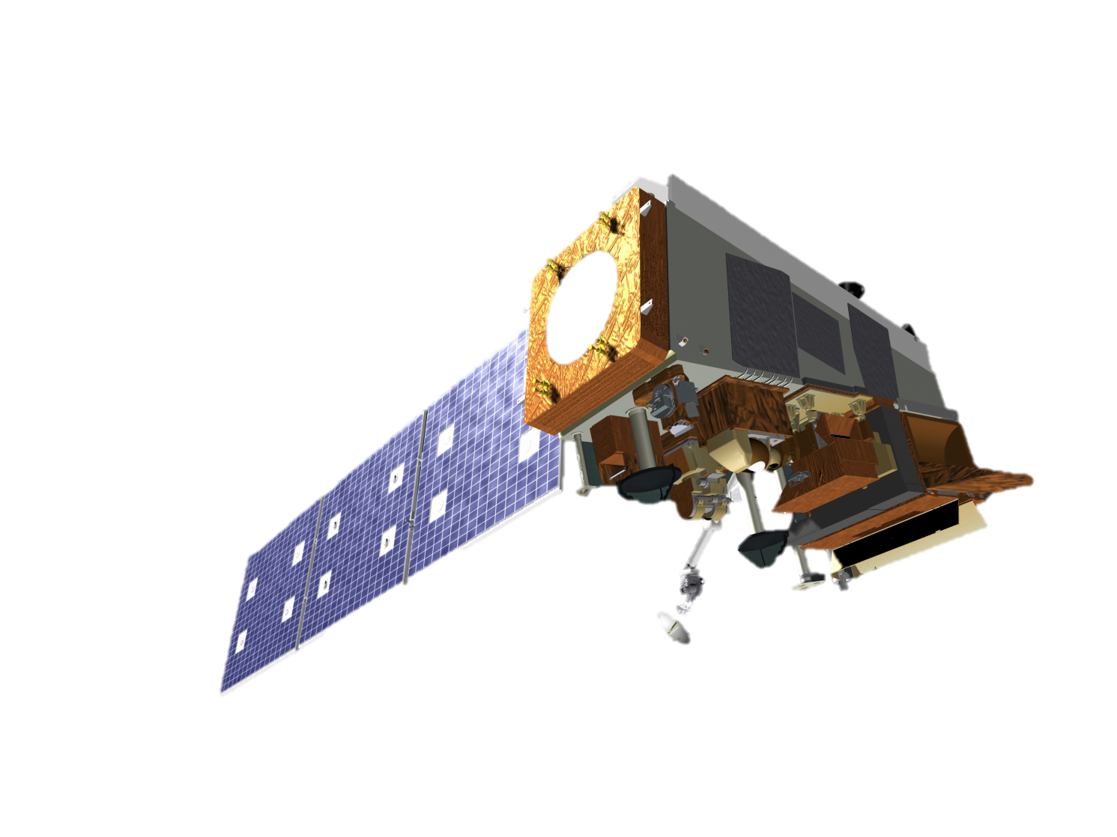
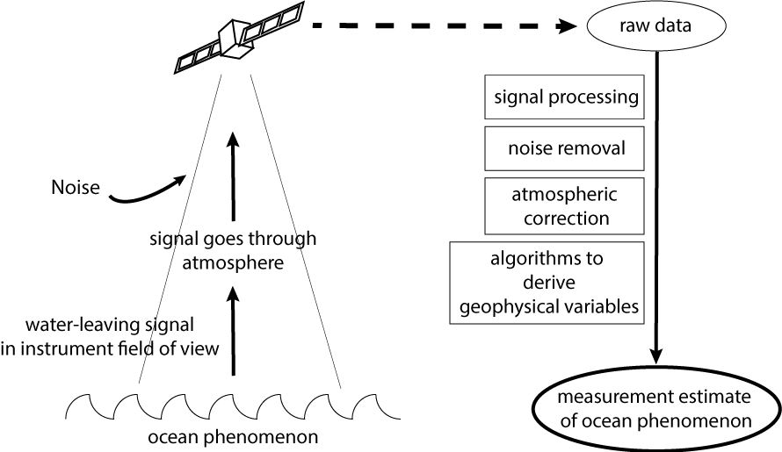

The presentation will cover the following topics
  Satellite 101, Part 2:
  Electromagnetic Radiation (EMR)
  Atmospheric windows
  Atmospheric correction
  How signal collected by sensors becomes information
  Passive vs. active sensors
Notes:
In Part 1 I gave an overview of available oceanographic satellite products and presented the different types of orbits, resolutions and spatial coverages and other general information. In this presentation we will get into some of the nitty gritty details about how satellite measurements are made. I will discuss how light propagates through the atmosphere and water column, and back out to the satellite sensor. I will introduce the different types of sensors and get into some of the details of how measurements are made. We also have additional presentations that go into greater detail about how certain measurements and products are made.

Slide 3
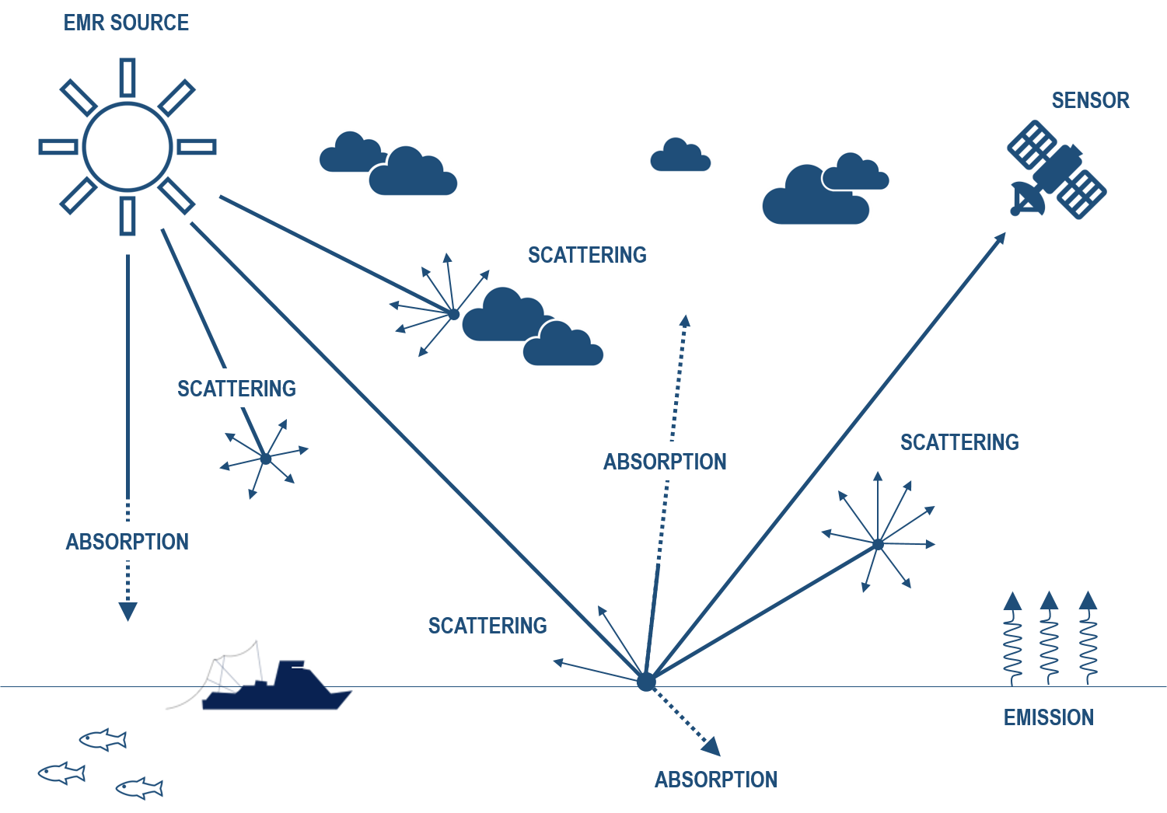
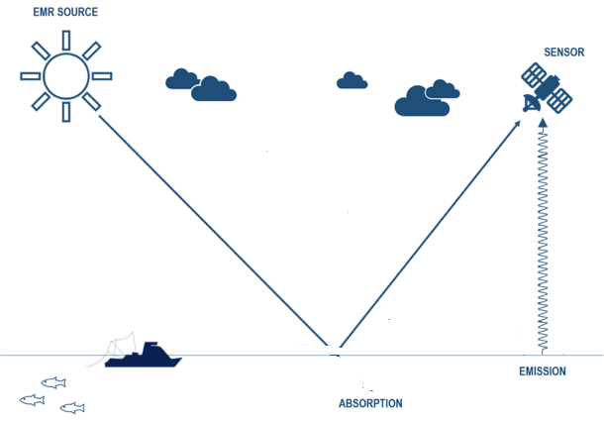
Satellite measure electromagnetic radiation (EMR)
Solar Black Body Radiation
Visible and IR wavelengths
(ocean color)
Emitted from the Sun
Reflected from the ocean
Earth Black Body Radiation
IR and microwave wavelengths
Emitted from the Earth
REFLECTION
EMISSION
Credit: Jan Yoshioka, CI
Notes:
As satellites fly over a region of the ocean, its sensors record light, or electromagnetic radiation, within its field of view. The radiation measured by the satellite has either been emitted by the ocean, or has been emitted by the sun and reflected by the ocean. In both cases the radiation passes through the atmosphere before being received by the satellite sensor. There are multiple processes that can affect the signal as it passes through the atmosphere.

Slide 4
Processes alter the EMR signal as it passes through the atmosphere
ABSORPTION &
SCATTERING
ABSORPTION &
SCATTERING
ABSORPTION
SCATTERING
SCATTERING
ABSORPTION
SCATTERING
SCATTERING
ABSORPTION
EMISSION
Credit: Jan Yoshioka, CI
Notes:
The atmosphere between the satellite and the ocean surface has big impacts on the signal that we want to measure. It can scatter or absorb the energy so that it is not detected by the sensor. Scattering of the energy can also result in detection of energy that is not coming from the ocean, and needs to be accounted for. Accounting for the absorption and scattering of energy in the atmosphere is part of the atmospheric correction process that is undertaken as part of creating usable products. A lot of corrections are necessary in order to obtain accurate estimates of the ocean phenomenon that we are measuring,.

Slide 5
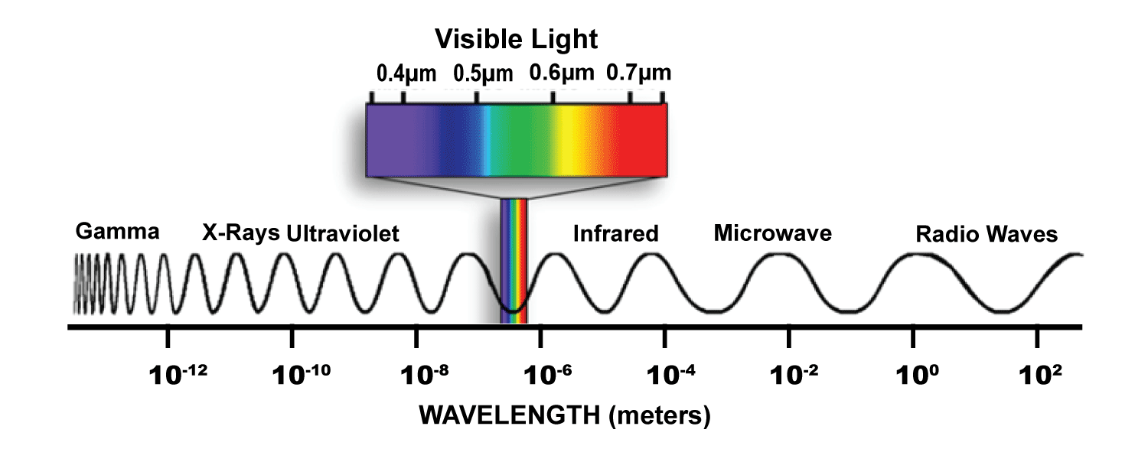
Electromagnetic Radiation (EMR)
Energy is emitted from the sun and the surface of the Earth
Photons travel at different wavelengths
Visible, infrared, and microwave wavelengths bands are most useful for remote sensing
Visible Light
10⁻⁶
10⁻⁴
10⁻²
10⁻⁰
10²
10⁴
10⁶
10⁸
WAVELENGTH (μm)
Notes:
Let’s talk about electromagnetic radiation, or EMR, in more detail. As energy is emitted from the sun and the surface of the Earth, photons travel at different wavelengths. The EMR spectrum is divided into bands by wavelength ranges. Wavelength bands useful for remote sensing are in the visible, infrared (IR), and microwave wavelengths, which is the area indicated by the shaded box on this slide.

Slide 6
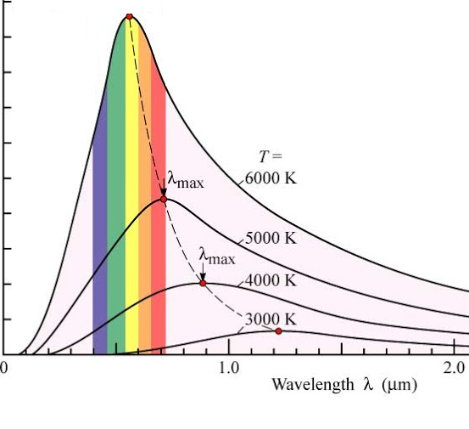
Natural sources of EMR come from black body radiation
Black body emissions as a function of temperature
All “things” or “bodies” emit (EMR)
The spectrum of the emission depends on the temperature of the body
At lower temperatures:
the intensity of the emissions decreases
the peak of the emissions curve shifts to longer wavelengths
Emissions intensity (relative)
WAVELENGTH (μm)
Notes:
Planets and stars emit radiation, called black body radiation. There is a close relationship between the spectrum of the light they emit and their temperature. The lower their temperature, the weaker the intensity of the light they emit, and the higher their peak wavelength, as can bee seen here in the graphs of emission intensity versus wavelength for a number of different temperatures.

Slide 7
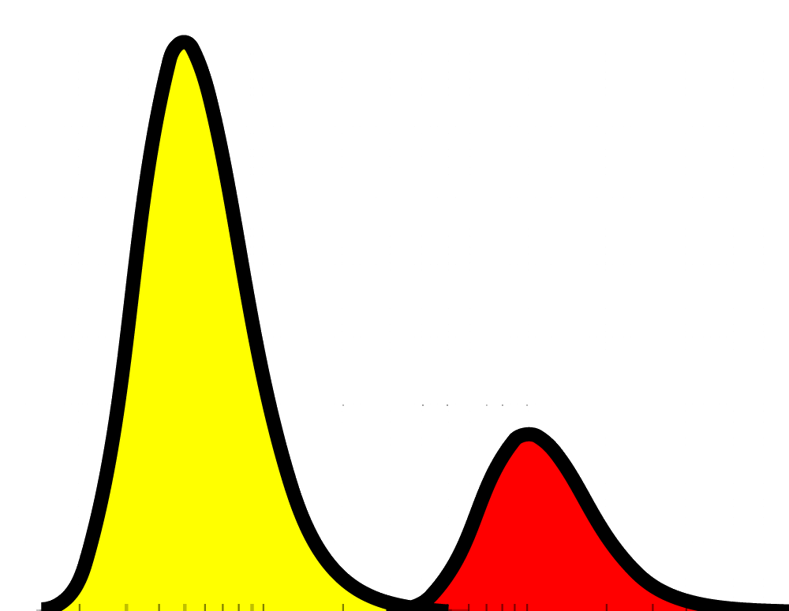
Satellite sensors measure electromagnetic radiation (EMR)
Black Body Emissions
Sun’s emissions
Temperature: 6000º K
Peak in the visible
Weaker Infrared emissions
Earth’s emissions (increase x 10⁶)
Temperature: 288º K
Peak in the Infrared
Weaker microwave emissions
Emissions intensity (relative)
10⁻⁶
10⁻⁴
10⁻²
10⁻⁰
10²
10⁴
10⁶
10⁸
^{WAVELENGTH (μm)}
Remote
Notes:
If we compare the sun’s emission vs the earth’s emission, we can see that because the sun is much warmer than the earth, the intensity of its light is much higher, and it’s spectrum peaks in the visible, whereas the Earth’s emission peak is at longer wavelengths in the thermal infrared, with a much weaker intensity. The light that is received by the satellite sensors is a combination of the two and their interaction with the atmosphere.

Slide 8
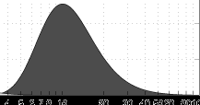
Emissivity is a measure how efficiently blackbody radiation is emitted
The blackbody emissions curve for Earth assumes that the Earth behaves like a perfect blackbody, meaning its completely driven by temperature.
In reality, parts of the earth emit EMR at only a fraction (call emissivity or “e”) of that of a perfect blackbody:
For open water and sea ice: e = .98 in the infrared
For open water: e = .4 in the microwave
For sea ice: e = .8
In addition, e changes as a of function of wind speed, temperature, and salinity, allowing the determination for these parameters.
Theoretical Earth blackbody emission curve
where e = 1.0
20
W m⁻² μm⁻¹
10
4
10
20
50
100
WAVELENGTH (μm)
Notes:
Earth is not a perfect black body, meaning that other properties aside from temperature impact how effectively radiation is emitted from the earth. Emissivity is a measure of how effectively an object emits thermal energy. And we can take advantage of the changes in emissivity to measure different properties in the ocean. For example while water and sea ice have a similar emissivity in the infrared, their values in the microwave portion of the spectrum are very different, allowing for differentiating sea ice from water.

Slide 9
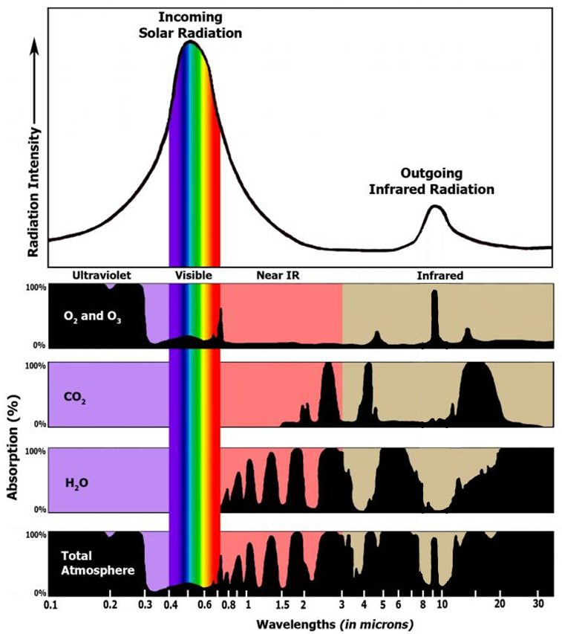
Useful wavelengths are limited by the Earth’s atmosphere
Source: NASA
The atmosphere is opaque to EMR at many wavelengths, due to absorption by atmospheric gases.
EMR is fully or partly transmitted through the atmosphere at only specific wavelengths.
Remote sensing makes use of these “atmospheric windows”.
WAVELENGTH (μm)
Notes:
The influence of the atmosphere depends on the wavelength of electromagnetic radiation. The atmosphere is opaque to radiation at many wavelengths, due to the absorption by atmospheric gases, these are the areas shown in black on these graphs. There are only certain wavelengths through which radiation may be fully or partly transmitted. Remote sensing focuses on those transmission ranges, the so-called atmospheric windows, which are the non-black regions.

Slide 10
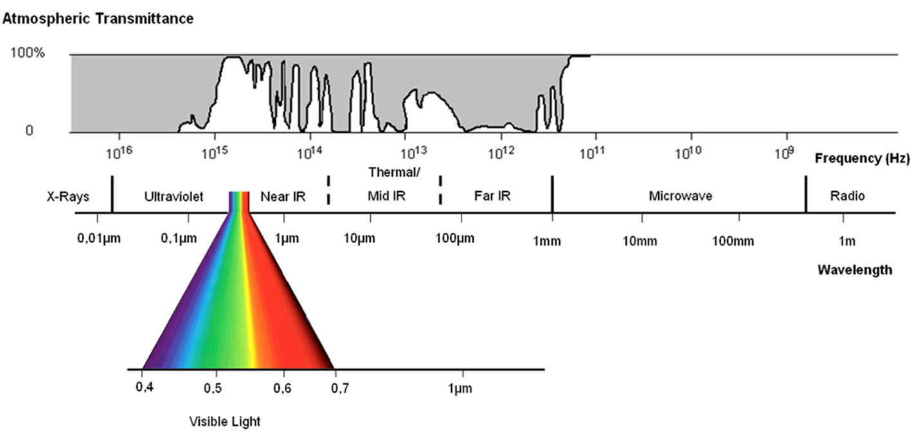
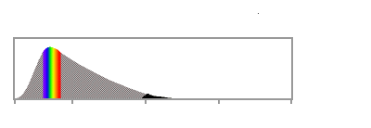
Atmospheric windows for EMR
  Satellites can ‘see’ the earth in the regions of high atmospheric transmittance (ie low absorption)
Atmospheric Transmission
WAVELENGTH (μm)
10⁻²
10⁻¹
10⁻⁰
10¹
10²
10³
10⁴
10⁵
10⁶
Emitted EMR Intensity
EMR Intensity
Solar EMR
top of atmosphere
emitted by the earth
emitted by the sun
Notes:
Transmittance is the opposite of absorption. Where there is a little absorption, there is high transmittance. Satellites can “see” the earth, through the atmosphere in the regions of high transmittance, the white areas on this figure.

Slide 11
No atmospheric windows occur in X-Ray and shorter UV wavelengths
  X-Ray and shorter Ultraviolet wavelengths are almost totally attenuated.
  Therefore these EMR bands are less relevant for remote sensing.
Atmospheric Transmission
WAVELENGTH (μm)
10⁻²
10⁻¹
10⁻⁰
10¹
10²
10³
10⁴
10⁵
10⁶
Emitted EMR Intensity
EMR Intensity
Solar EMR
top of atmosphere
emitted by the earth
Notes:
X-Ray and shorter Ultraviolet wavelengths are almost totally attenuated, therefore these EMR bands are less relevant for remote sensing.

Slide 12
Visible light passes through the atmosphere without much attenuation
  Atmospheric transmittance is high in visible bands, where solar EMR emission is highest
Atmospheric Transmission
WAVELENGTH (μm)
10⁻²
10⁻¹
10⁻⁰
10¹
10²
10³
10⁴
10⁵
10⁶
Emitted EMR Intensity
EMR Intensity
EMR Intensity
Solar EMR
top of atmosphere
emitted by the earth
emitted by the sun
Notes:
In the visible wavelengths, where the sun emits at the highest intensity, the atmospheric transmittance is high.

Slide 13
Infrared passes through narrow atmospheric windows
  In the infrared, high transmittance occurs in narrow bands. This includes the optical windows in the thermal infrared, where the Earth's surface emits radiation.
Atmospheric Transmission
WAVELENGTH (μm)
10⁻²
10⁻¹
10⁻⁰
10¹
10²
10³
10⁴
10⁵
10⁶
Emitted EMR Intensity
EMR Intensity
Solar EMR
top of atmosphere
emitted by the earth
emitted by the sun
Notes:
At higher wavelengths, transmittance is reduced to narrow bands. This includes the optical windows in the thermal infrared, where the Earth’s surface emits radiation.

Slide 14
Microwaves passes through the atmosphere without much attenuation
  In the microwave, atmosphere transmission is near 100%.
  But emission in the microwave by are relatively weak, so large antennas and large sensor footprints are needed to collect enough radiation for measurements.
Atmospheric Transmission
WAVELENGTH (μm)
10⁻²
10⁻¹
10⁻⁰
10¹
10²
10³
10⁴
10⁵
10⁶
Emitted EMR Intensity
EMR Intensity
Solar EMR
top of atmosphere
emitted by the earth
emitted by the sun
Notes:
In the microwave, the atmosphere is nearly transparent, but radiation from the sun and earth is weak, so we need large antennas to collect enough radiation

Slide 15






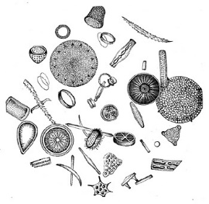

EMR is also affected by the water properties
🛰
EMR emitted by the sun is transmitted through the atmosphere to the ocean.
EMR interacts with elements in the ocean, where the spectral characteristics are changed
EMR reflected from the ocean is transmitted through the atmosphere and reaches the sensor
V/UV
Water-leaving Radiance
B
Downwelling Irradiance
G
Y
O
R
NIR
AIR
SEA
SCATTERING
Possible fates of a photon entering
the water
Organic Matter
Detritus
Phytoplankton
TRANSMISSION
Image Credit: jeremy.werdell@nasa.gov
ABSORPTION
Notes:
As I mentioned earlier, sensors measure electromagnetic radiation that is either reflected or re-emitted from the ocean. Light from the sun passes through the atmosphere and if it reaches the ocean surface it may reflect off of the surface or pass through it. Photons entering the water will either be scattered or absorbed. If absorbed, phytoplankton, non-algal particles, colored dissolved organic matter, called CDOM, or water itself will absorb the light. If scattered, it will do so in either the forward or backward direction. If in the backward direction, some of it will be re-emited from the sea surface and will be detected by a sensor. We are interested in the remote sensing reflectance, at specific wavelengths, and from these we derive the concentration of chlorophyll and other products. More details are given about this in our presentation on ocean color.

Slide 16
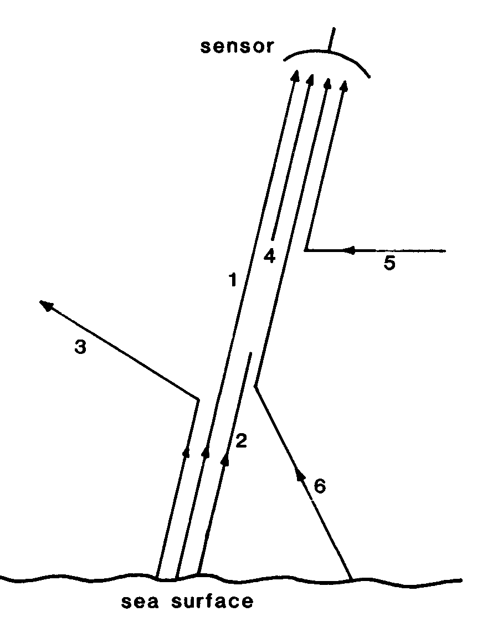
Atmospheric Pathways of EMT between the ocean and the satellite
Emitted from the sea within the sensor’s footprint
Ray 1 - the useful signal, radiation leaving the ocean and measured by the sensor
Ray 2 - radiation leaving the ocean that is absorbed by the atmosphere
Ray 3 - radiation that is scattered by the atmosphere out of the sensor field of view
Reaching sensor from sources outside its footprint
Ray 4 - radiation emitted by the constituents of the atmosphere
Ray 5 - radiation reflected by scattering into the field of vision of the sensor
Ray 6 - radiation from the ocean but from outside the field of view.
sensor
What the sensor receives
4
1
5
3
2
6
What we want to measure
sea surface
sensor’s footprint
atmospheric corrections are necessary to derive accurate satellite data products.
Notes:
Ideally, we want to measure all of the signal within the sensor’s footprint or field of view. In reality, not all of the signal makes it to the sensor. In addition, stray emissions from outside the footprint add noise to the signal reaching the sensor. In the diagram, the rays in green show the fates of the signals coming off the ocean that we want to measure. Some of the rays make it to the sensor. Others are either absorbed by the atmosphere or scattered out of the sensor’s field of view. The red rays represent the stray radiation reaching the sensor from outside its footprint on the sea. Atmospheric corrections are is needed to account for the missing signals, and remove the extraneous ones.

Slide 17
Atmospheric Correction
Most of the absorption/re-emission of IR in the atmosphere is caused by a few gases (O₂, N₂ and trace gases) that are relatively well-mixed,
and by water vapor, ozone and aerosols, that are not well mixed.
The well-mixed components cause a constant difference in temperature between the surface and the satellite.
The variable components must be detected and corrected for using multiple wavelengths.
Atmospheric correction is necessary to derive accurate satellite data products.
Notes:
Some of the atmospheric components that scatter or absorb the ocean signal are well-mixed, like oxygen and nitrogen, but others are not. The distributions of water vapor, ozone and aerosols are very heterogeneous, and these components must be measured in order to correct for their impact on the satellite signal.

Slide 18
The process of converting the EMR signal to information
Notes:
So to sum up, a lot of different processes that affect EMR need to be accounted for and corrected for in order to get accurate measurements. This course focuses on the application of the finished products, but recognizes that its important to understand a bit of the “sausage making” that has gone into the generation of these products.

Slide 19
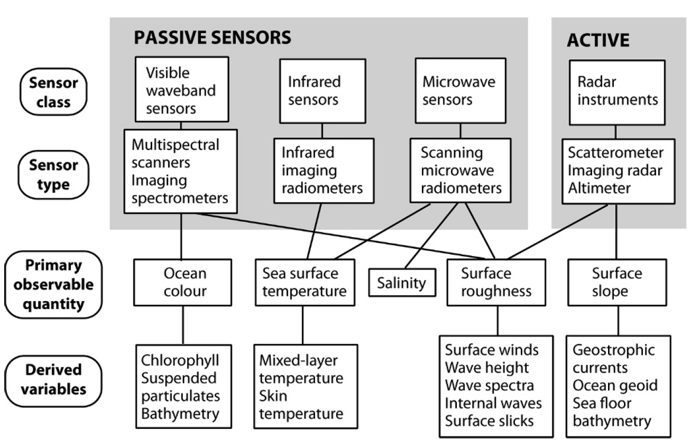
Types of Sensors and Products
From Robinson, Discovering the Ocean from Space
Notes:
Depending on the application they were designed for, sensors measure different parts of the electromagnetic spectrum. There are sensors that operate in the visible, the infrared, and microwave sensors, including radar instruments. Sensors target specific wavelengths depending on their application. Some products can only be measured in one part of the spectrum, for example ocean color can only be measured in the visible, whereas sea-surface temperature measurements can be made in both the infrared and the microwave portions of the spectrum.

Slide 20
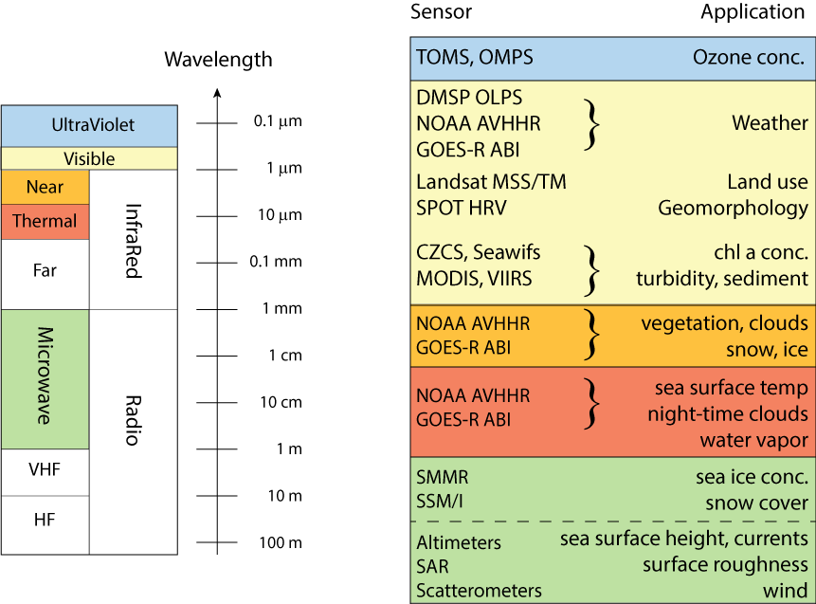
EMR Spectrum and Applications
Notes:
This slide maps out examples of the sensors and applications that are each part of the spectrum. In the yellow box are sensors that operate in the visible, which include SeaWIFS, MODIS, and VIIRS, the primary sensors for measuring ocean color. From ocean color measurement we can derive chlorophyll concentrations, turbidity and a whole suite of other products. Measurements of sea ice are made in both the near-IR and in the microwave. Other measurements made in the microwave include sea surface height, currents, wind, salinity and temperature.

Slide 21
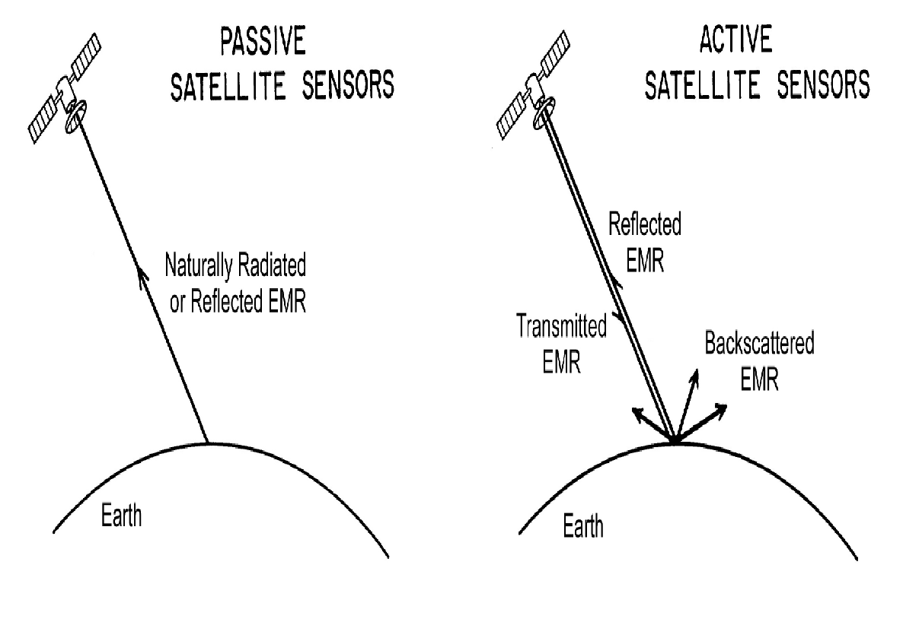

Passive vs Active Sensors
Passive Remote Sensing
Reception of EMR signals from natural source
Either EMR from the Sun that is reflected off of the earth or EMR emitted by the Earth
Active Remote Sensing
Reception of EMR signals from a pulse emitted by a satellite
The pulse is directed to the earth and the reflected signal is captured by the satellite sensor
Notes:
There are two basic technologies used for satellite sensors. Passive sensors detect radiation from two natural sources, the sun and the earth. Active sensors measure signal that is reflected back from a pulse of energy sent down by the sensor. Most of the sensors used for oceanographic remote sensing are passive. Examples of active sensors are altimeters, scatterometers, lidars, radars.

Slide 22
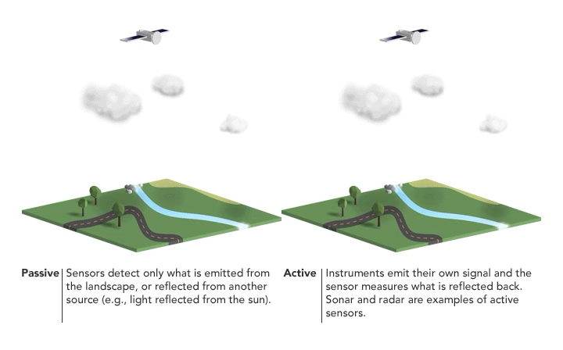
Passive vs. Active Sensors
Image Credit: NASA ARSET
Notes:
This is an animation illustrating those two concepts.

Slide 23
Science Quality vs NRT
Science Quality data has undergone better Quality Control, and has latency periods of several weeks to several months. These data are typically are used to look at trends over time, and for use in publications.
Near-Real time (NRT) data, is data with the shortest latency possible, hours to days.
To achieve this short latency these datasets have undergone minimal Quality Control.
For datasets that are periodically reprocessed, the older versions should be labelled “deprecated” on data servers (i.e. ERDDAP).
Notes:
23
It takes time to do all the processing necessary for atmospheric correction as well as performing quality-control. Science quality data has undergone rigorous processing and, depending on the product, can have latencies between a few weeks to a few months. For analyzing trends over time its best to use science-quality data. However, some applications need data as soon as possible. To accommodate this need, some products are also offered as near-real time products, with a latency of hours to days after collection. Near-real time products have undergone a less rigorous processing and so should be used with caution.

Slide 24
NOAA CoastWatch Satellite Course - Narrated Presentations
Satellite 101 – Part 1
Satellite 101 – Part 2
Fundamentals of Ocean Color
Fundamentals of Sea-Surface Temperature
Fundamentals of Altimetry, Wind and Salinity
Introduction to ERDDAP
What Dataset to Choose?
Bringing Satellite Data into ARCGIS
Notes:
This concludes part 2 of the Satellite 101 presentations. We have additional presentations that go into greater details about how measurements are made for ocean color, sea-surface temperature and altimetry, winds and salinity.

